Slide 1

PROJECT-1: SQL: Olympic -I
OLYMPIC DATABASE
MANJYANAIK V D
Data Analyst
Problem Statement:
The Olympic Data set has participation details of athletes for various Olympic events. Explore the dataset and try to solve all the questions.

Slide 2
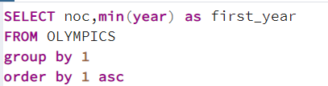
2.Create a table having NOC name of the country and its first year of participation (name the column as ‘First_Year'. The output should have just two columns: the National Olympics Committee (NOC) name and the first year of participation. Sort records by NOC in ascending order.

Slide 3

3. Find names of the players who participated in the Olympics representing more than one team.

Slide 4
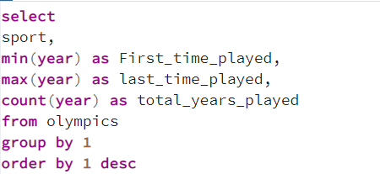
4. Find the history of each sport by finding the first year, the last year, and the total number of years that sport was played in the Olympics. The output should be sorted by sport DESC order

Slide 5
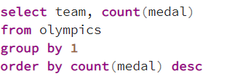
5. Find team-wise count of medals won. The output should be sorted by medal count in descending order

Slide 6
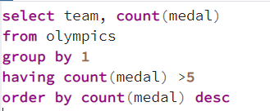
6. Find the team names who have won more than 5 medals (excluding 5). Also, show the count of medals against every team. The output should be sorted by medal won in descending order

Slide 7
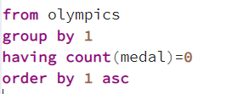
7.Find the list of the teams who have never won any medal so far. Team names in ascending order of names.

Slide 8
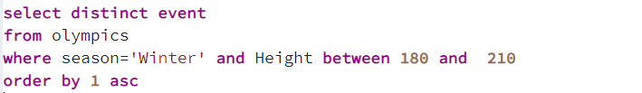
8. Find events of any Winter Olympics in which there were athletes of height between 180 to 210 centimeters. Output unique events only. Output should be sorted by Event name in ascending order

Slide 9
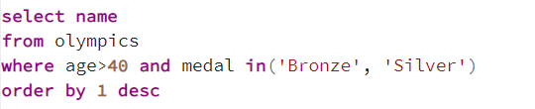
9.Find all athletes who were older than 40 years when they won either Bronze or Silver medals. Athletics names in descending order

Slide 10
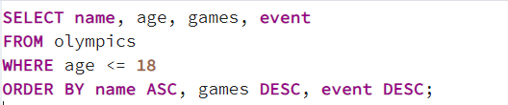
10.Find all minors (age less than or equal to 18) that participated in the Olympics games. The output should be sorted by name in ascending order, then game in ascending order, then event in desc order

Slide 11

11. Find all events participated by Christine Jacoba Aaftink. Unique Event column only sorted in ascending order

Slide 12
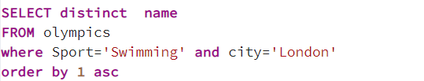
12.Find the athletes who competed in swimming events at the London Olympics. Unique athlete's name with the above condition sorted in ascending order

Slide 13

13.Find all Danish athletes (athletes from Denmark) who won a medal.

Slide 14
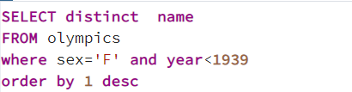
14.Find unique names women athelets who participated in an Olympics before World War 2. Let's consider the year 1939 as the start of WW2.Name column only sorted in descending order

Slide 15
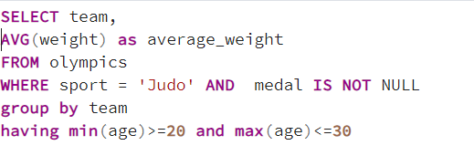
15.Find the average weight of medal-winning Judo players of each team with a minimum age of 20 and a maximum age of 30. Consider players at the age of 20 and 30 too.

Slide 16
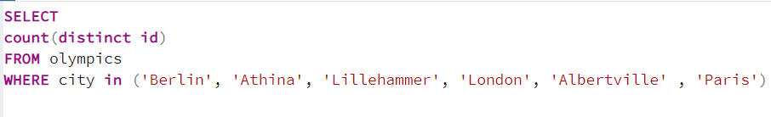
16.Find the number of athletes who participated in the Olympics that were hosted in European cities. European cities: Berlin, Athina, Lillehammer, London, Albertville and Paris.

Slide 17
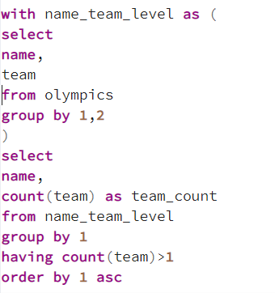
17.Get a list of athletes who have played in more than one team. order should be sorted in ascending order of athletes names

Slide 18
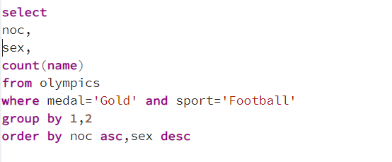
18.Find how many athletes competing in Football won Gold medals. ordered by NOC ascending first, then order by Sex in descending order

Slide 19
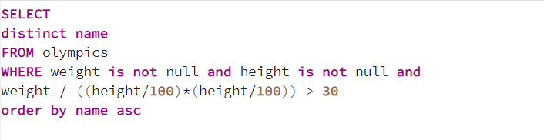
19.Find the list of athletes with more than 30 BMI participated.The table should be sorted by names in ascending order

Slide 20

20.Find the lowest, average, and highest ages of athletes across all Olympics.

Slide 21
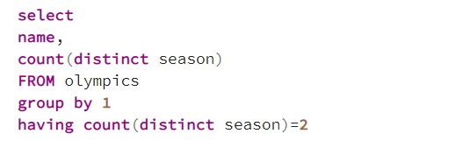
21.Find the name of athletes who participated in both the Summer and Winter seasons. The output should be sorted in descending order.

